Slide 1
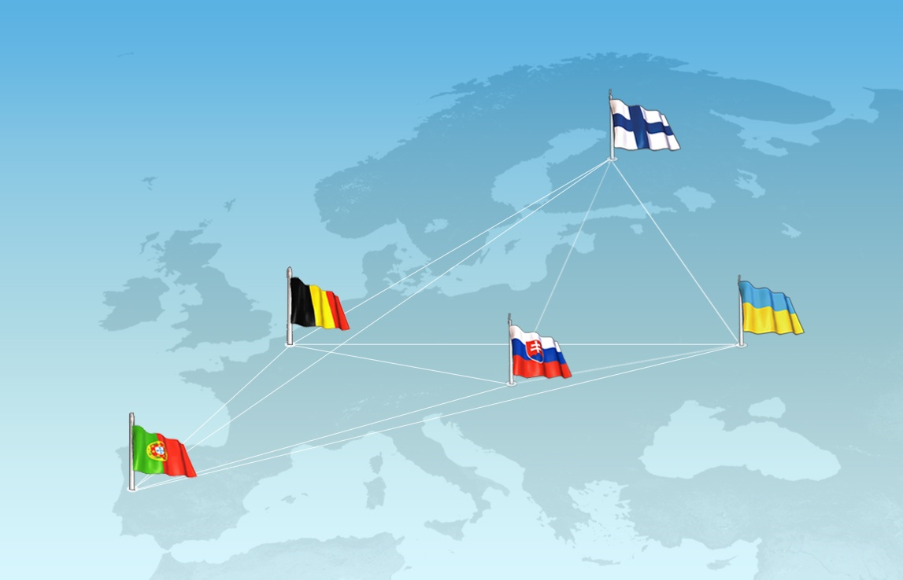











Towards Trust in Quality Assurance Systems
516935-TEMPUS-1-2011-1-FITEMPUS-SMGR
(2011-2015)

Slide 2
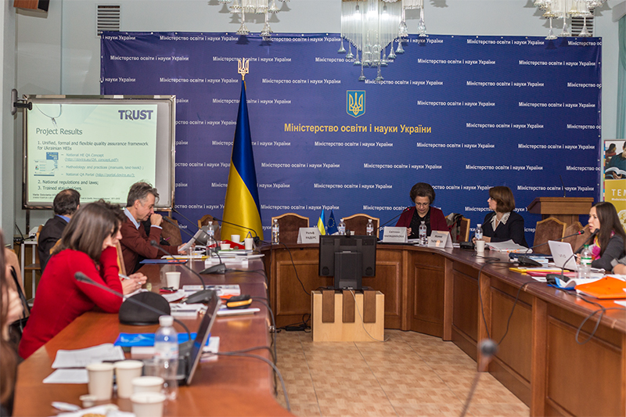
This presentation is prepared to the
Ministerial seminar on capacity building of the higher education within structural measure projects of the Tempus programme held on 25.11.2015

Slide 3

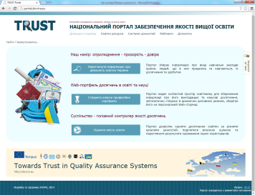
Project Results
1. Unified, formal and flexible quality assurance framework for Ukrainian HEIs
  National HE QA Concept (http://dovira.eu/QA_concept.pdf);
  Methodology and practices (manuals, text-book) ;
  National QA Portal (http://portal.dovira.eu/);
  2. National regulations and laws;
  3. Trained stakeholders.

Slide 4
Implementation level
Institutional:
internal QA (strategy development, annual transparent & trusted staff evaluation with different purposes)
National:
Electing the candidates for National QA Agency from private universities
Experts meeting (seeking)
International (beyond promised):
English version of the Portal provide trusted and evaluated visibility for the registered UA and any HEIs

Slide 5
Thank you!
516935-TEMPUS-1-2011-1-FITEMPUS-SMGR
Mariia Golovianko (KNURE), 20.11.2015
This project has been funded with support from the European Commission. This publication reflects the views only of the author, and the Commission cannot be held responsible for any use which may be made of the information contained therein.

